Slide 1
Car Crashes in the US in 2016

Slide 2
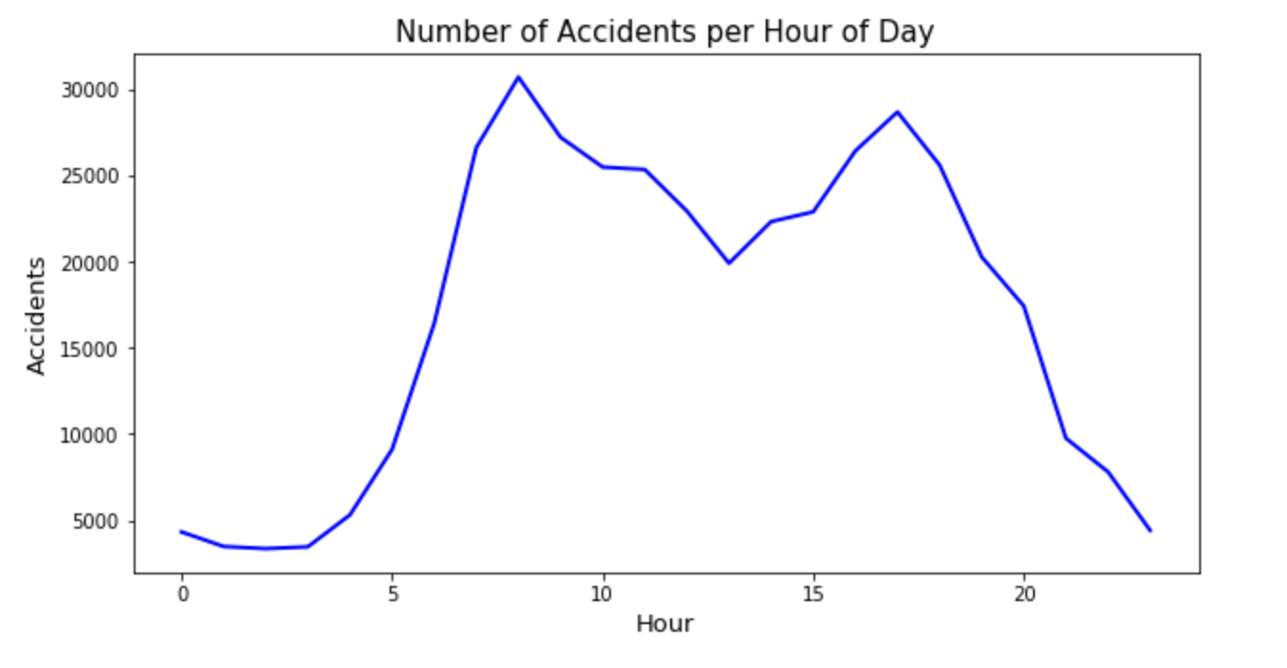
1. Relationship between number of accidents and time of the day OBJECTIVE : We tried to identify whether there is any relationship between the number of accidents and the time of the day accident happened. To conduct this analysis we grouped number of accidents by hour of the day (24 hour format). We used line graph to show the relationship.
OBSERVATION :
We can see that there is a spike in accidents during 7-9 Hours and 16-18 Hours. This indicates that more number of crashes occur during rush hours(commute to office hours).
IMPACT:
This might be because more people are rushing towards their work places or rushing back to their homes. This also leads to worsened traffic conditions as there are higher number of overspeeding cases and more traffic jams. This congestion also might be contributing to the spike.
SUGGESTION:
To counteract this, the government should implement tighter scrutiny. This will help curb the accidents on an hourly basis.

Slide 3
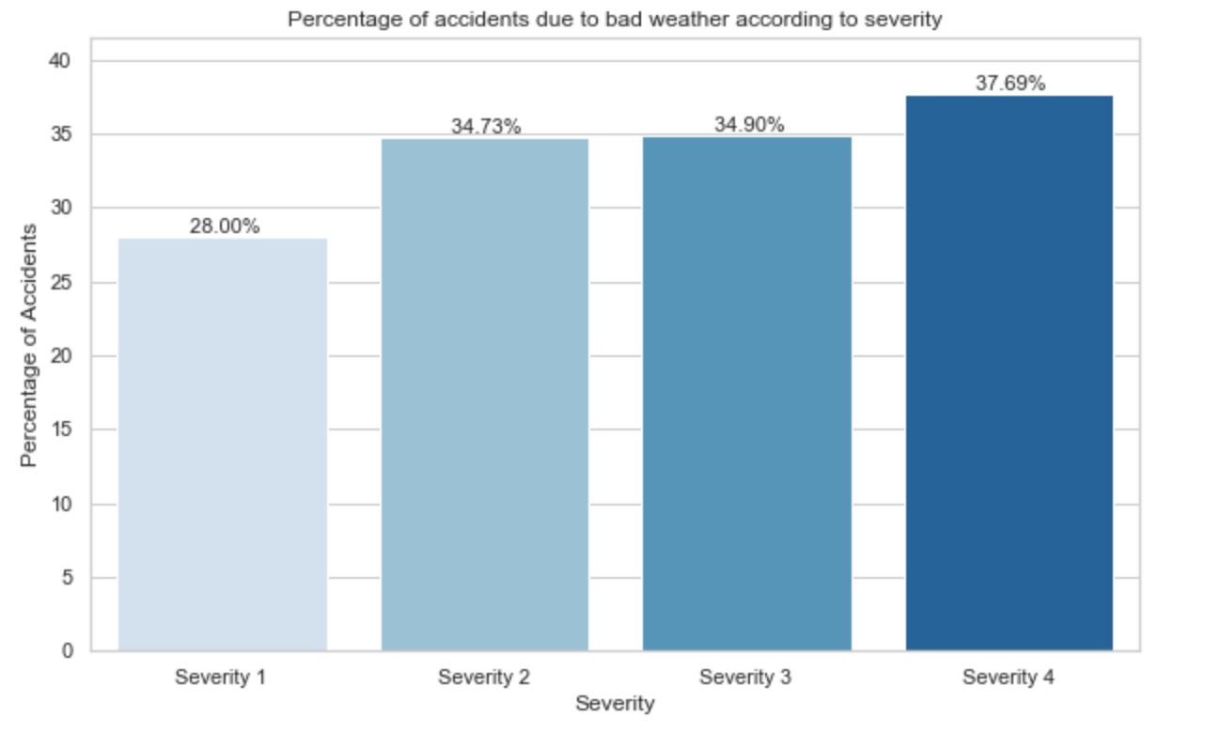
2. Relationship between number of accidents and bad weather OBJECTIVE : Common sense tells us that bad weather can play a role in causing accidents. We tried to see if our data tells the same. First we need to check whether bad weather plays a hand in the severity of accidents. For this analysis, we created two new logical columns (good_weather and bad_weather) by creating categories of "Weather_Condition" column. We categorized clear, fair and partly cloudly as good weather conditions and all values which represent heavy rain, snow and foggy conditions as bad weather conditions. We then constructed a vertical bar graph plotting the percentage of bad weather accidents per severity.
OBSERVATION :
As we can see, bad weather accounts for ~38% of Severity 4 accidents. Keeping in mind that bad weather accounts generally for about only 5-10% of the total climate in a year, their contribution increase to severe accidents is noteworthy.
IMPACT:
We can infer that poor visibility conditions, slippery roads etc. may be one of many reasons for such rise in Severity 4 cases by bad weather.
SUGGESTION:
By implementing better lighting on roads, setting lower speed limits when bad weather conditions are there may help bring down the severe accident proportion for bad weather.

Slide 4
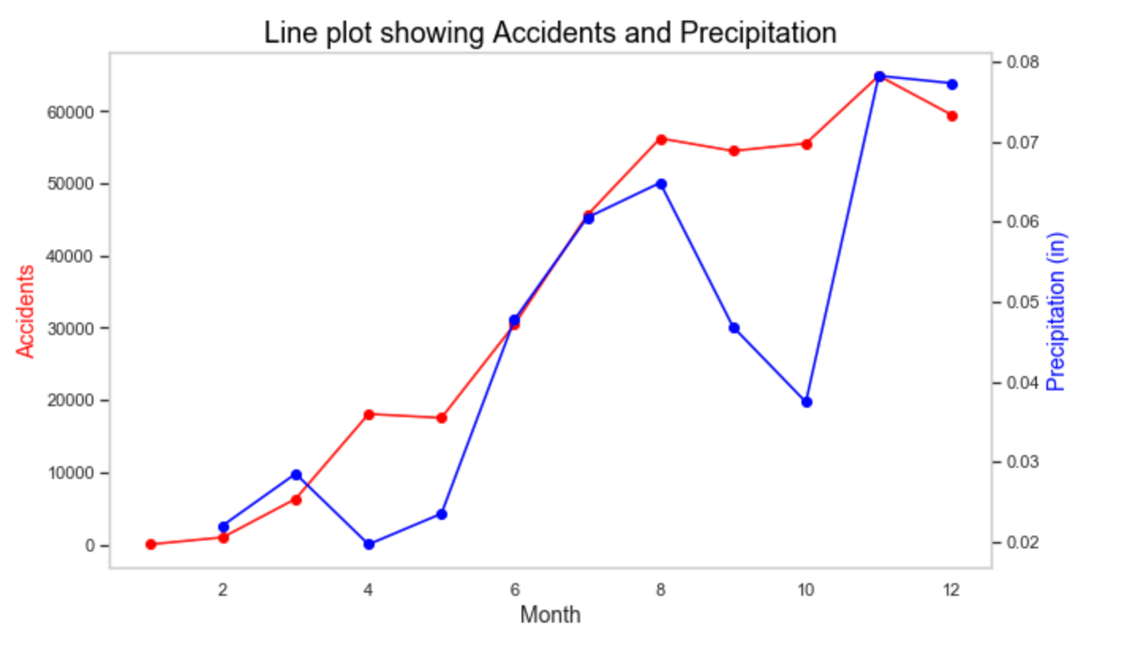
3. Relationship between month of accidents and precipitation OBJECTIVE : Now that we have confirmed that bad weather leads to more severe accidents, we try to narrow down the main reason behind car crashes during bad weather according to our data. We hypothesize that Preciptation could be one of the leading causes. Hence, we have Precipitation (in inches) which can be a good indicator of whether a particular area is hit by rain/snow/hail etc during the time of the accident. So, higher the precipitation, denser the rainfall/snowfall. So, we plot a multi y-axis line graph showing average precipitation per month and another line showing total accidents per month to see if there are any trendlines visible from the data. We chose a multi y-axis line graph because the scales for total accidents(in thousands) and preicipation (less than 1) are not same.
OBSERVATION :
We observe that the line plot for average precipitation per month and number of accidents per month show a similar trend.
IMPACT:
We can deduce that higher precipitation may lead to slippery roads which in turn leads to more accidents. This further confirms our hypothesis that there is a relation between accidents and bad weather.
SUGGESTION:
To counter this, the government needs to focus on reducing road slipperiness. Maintenence activities like drainage repair, snow removal and street sweeping need to be ramped up. More intensive measures can be taken at slippery accident prone zones like grinding or milling a surface that has worn smooth, overlaying a new asphalt layer etc.

Slide 5
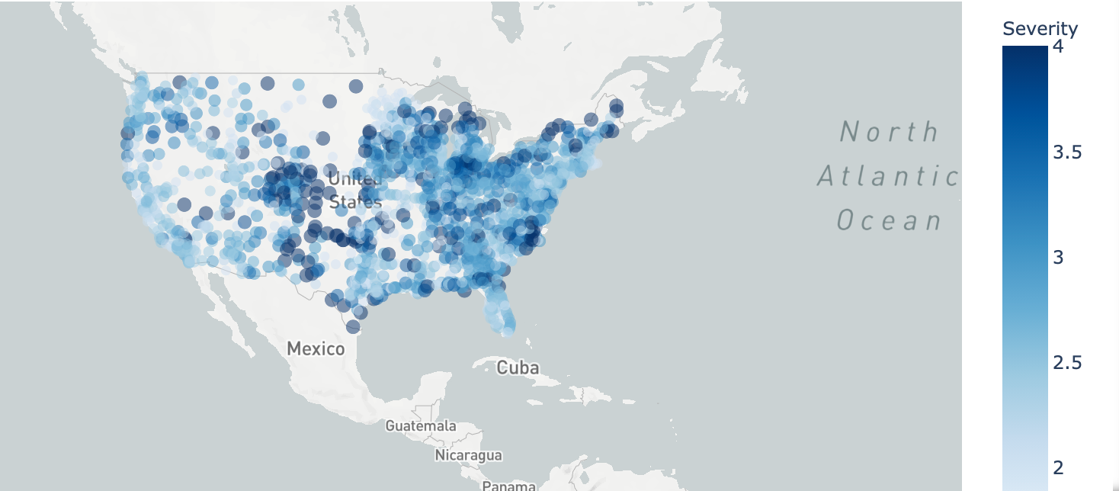
4. Relationship between Severity of accidents and States OBJECTIVE: Our next research question is to analyse if there is any relationship betweeen the number and severity of accidents and the states. We try to find if there are some states which are more prone to higher car crashes. To do this we grouped the data using Airport Codes so that we get a count of car crashes for all airport areas. The use of Airport Codes will group all neighboring cities into one geographical location. We have then calculated the mean of the severity of crashes with respect to the Airport codes.
OBSERVATION : Bubbles with varying sizes represent more severe crashes. As the colour darkens the severity of the crashes increase.
We can observe that Eastern states have far more crashes than the western states. There is a cluster of very high number of severe crashes in Colorado. Surprisingly, the severity of crashes in busier and more populous states such as California and New York is far lesser than we would expect. We can observe that states such as Nebraska, North Dakota, Nevada, Montana have very less number of accidents. In the next steps we will analyse the reasons behind high/low severity of car crashes in each state.

Slide 6
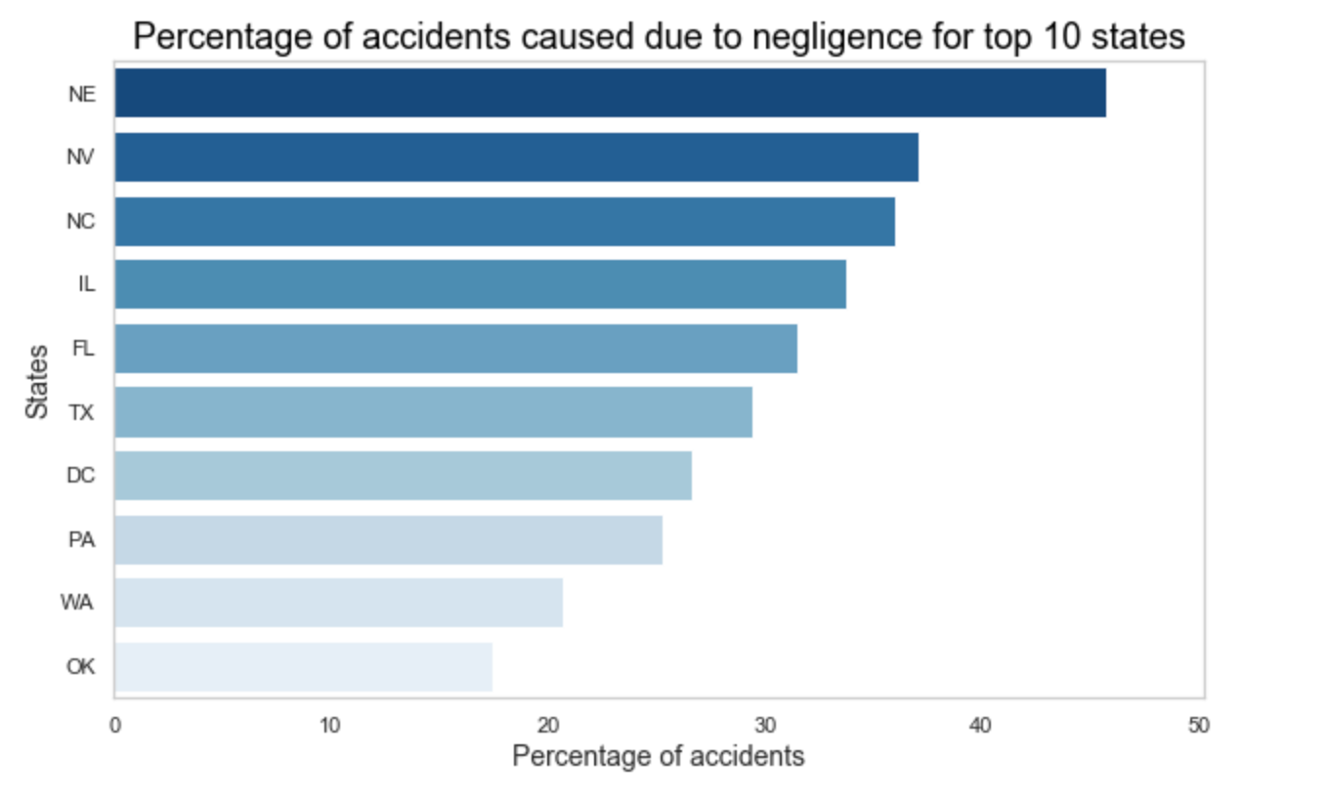
5. Top reason for accidents by state OBJECTIVE : Now that we have an overview of the states with higher cases of more severe accidents, our next reasearch question is to understand why these states have such high number of accidents. To decode this we decided to look at the traffic conditions attributes when the accident took place. We decided to take a look at accidents which take place at Stop Signs or Traffic Signals. Many people have the tendency to not follow traffic rules such as skipping traffic signals or not stopping at stop signs. We have considered these attributes as human errors. We found the percentage of car crashes taking place at stop signs and traffic signals for each state so we could rank each states on the percentage.
OBSERVATION :
We can see that Nebraska, Nevada, North Carolina are some of the top states for accidents due to negligence of citizens. States such as Nevada, North Carolina and Illinois had high number of car crashes and had more severe accidents as we had seen in the map before.
IMPACT:
The reason behind such large numbers and high intensity could be the negligence and tendency to not follow traffic rules. But what is most surprising is that Nebraska had very few car crashes cases but still has the highest percentage of accidents caused due to negligence. This shows that the citizens of Nebraska do not tend to follow traffic rules.
SUGGESTION:
Such states could implement tighter rules and penalize more for disobeying the law.

